Slide 1

Learn to prompt for continual learning
Submitted by:
Rohit Kumar 20963
Avnish Kumar 20964

Slide 2
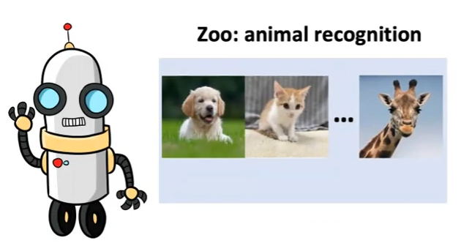
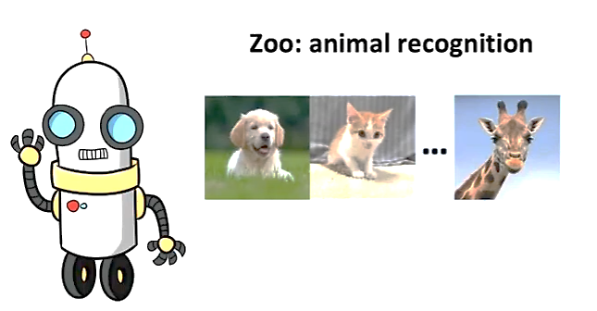
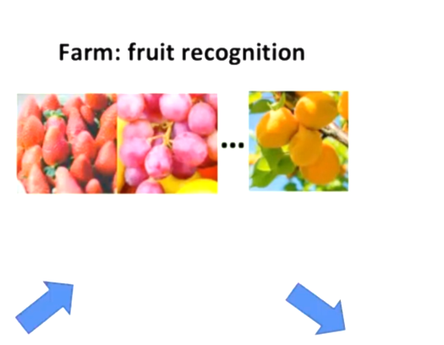
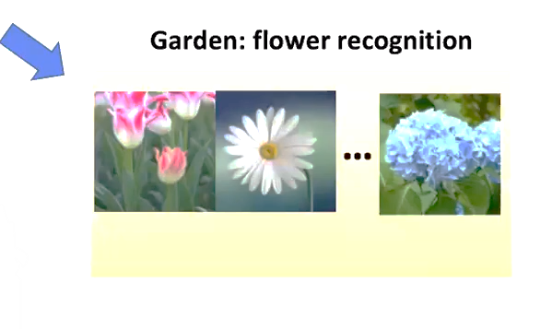

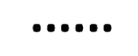
Motivation

Slide 3
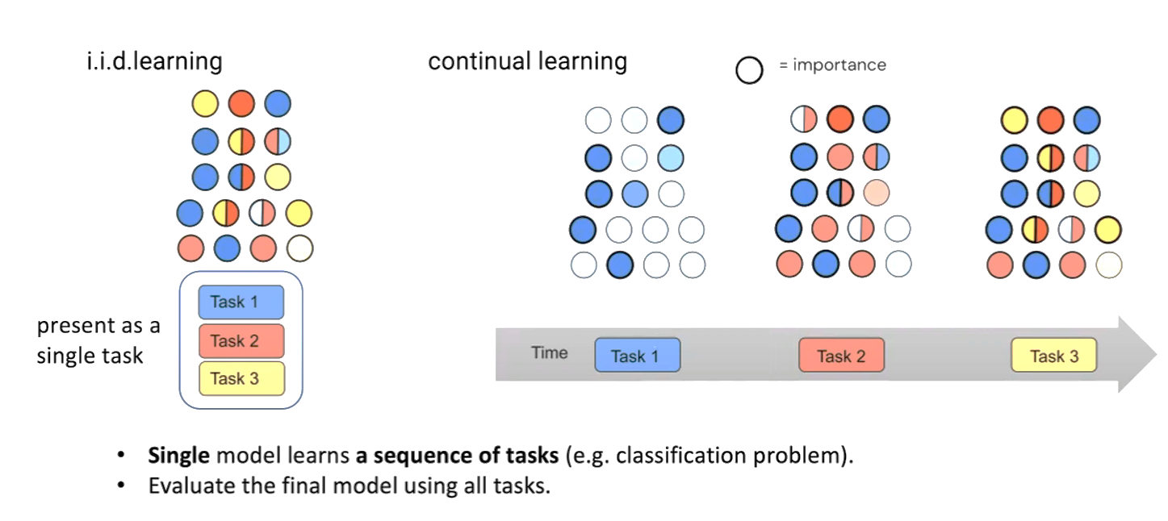
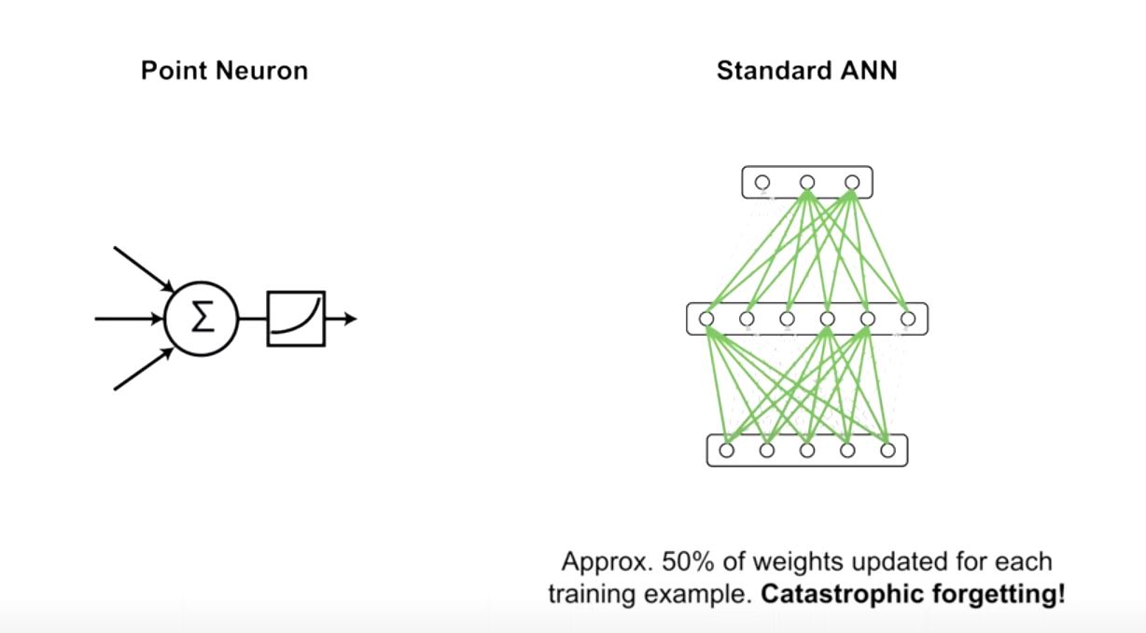
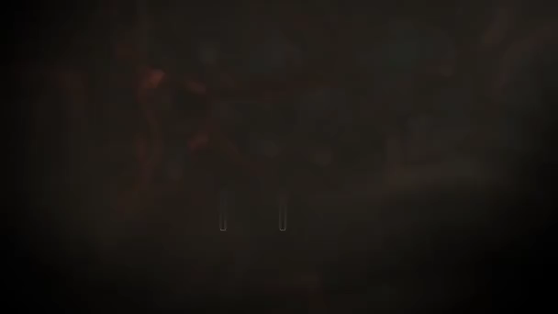
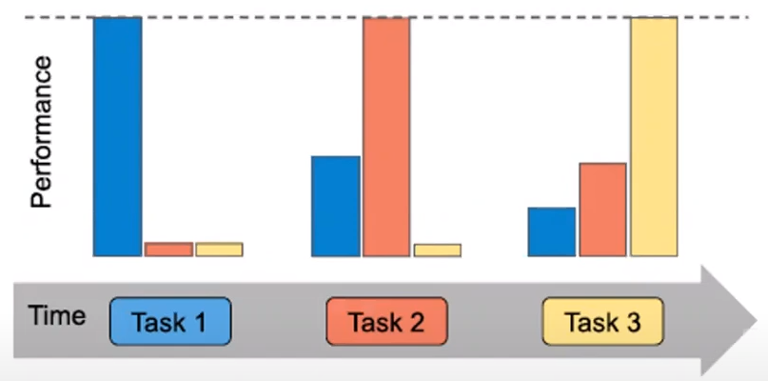
Catastrophic forgetting
Credit: Going beyond the point neuron

Slide 4
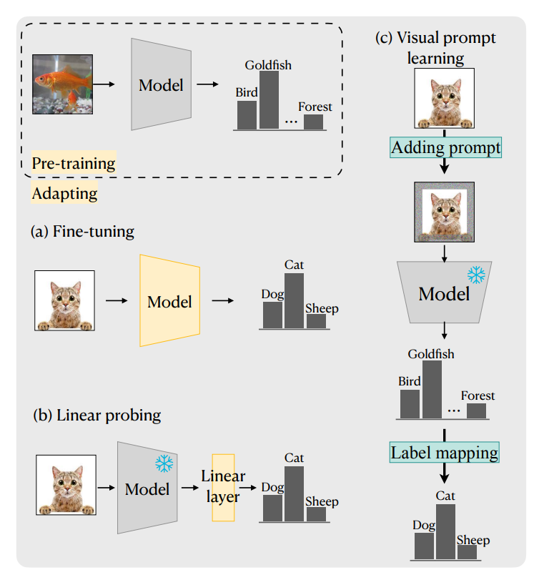
Credit: From Visual Prompt Learning to Zero-Shot Transfer: Mapping Is All You Need
Learning technique

Slide 5
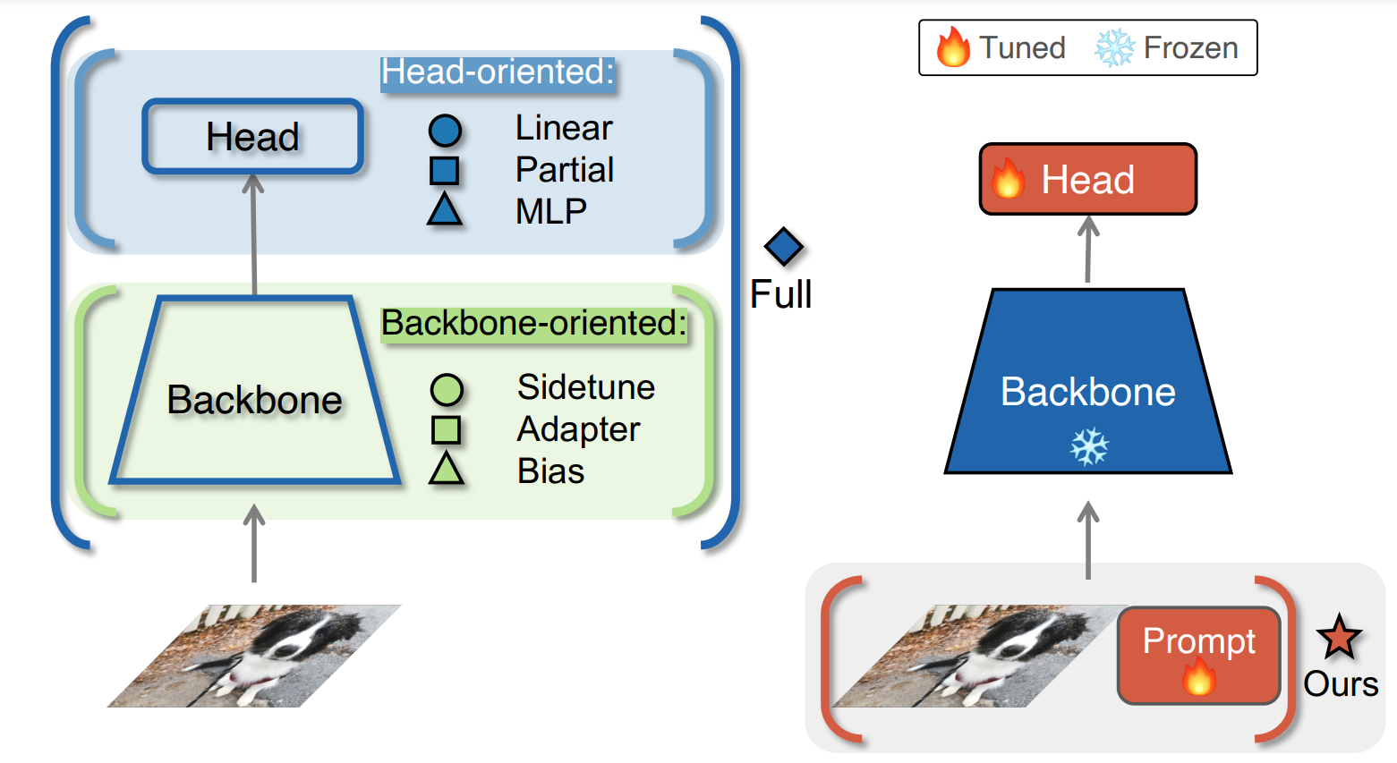
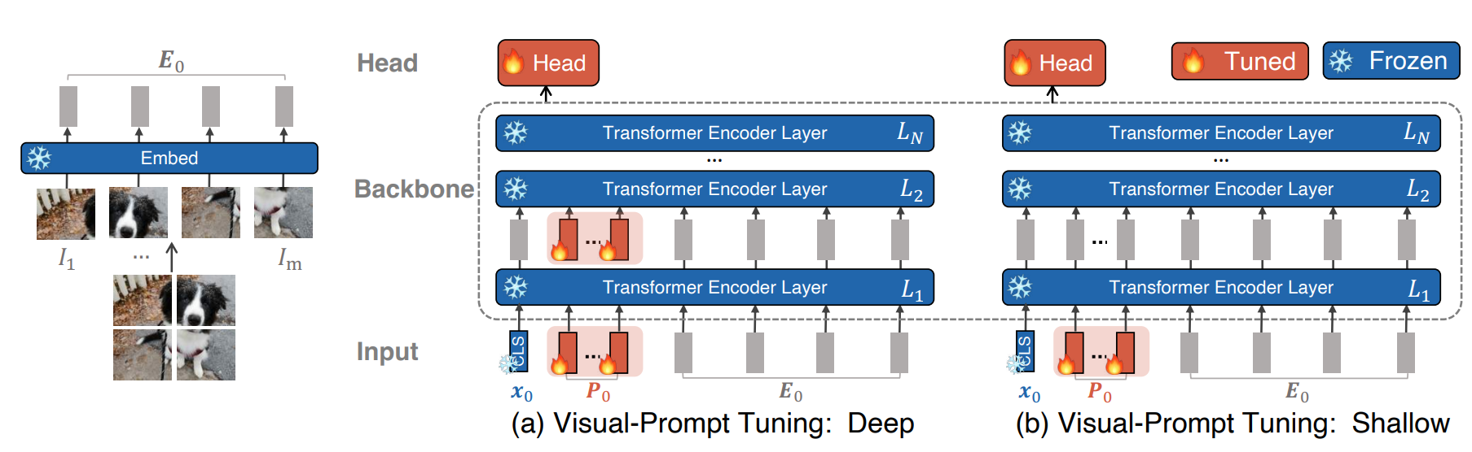
Prompt in ViT
Credit: Visual Prompt Tuning

Slide 6
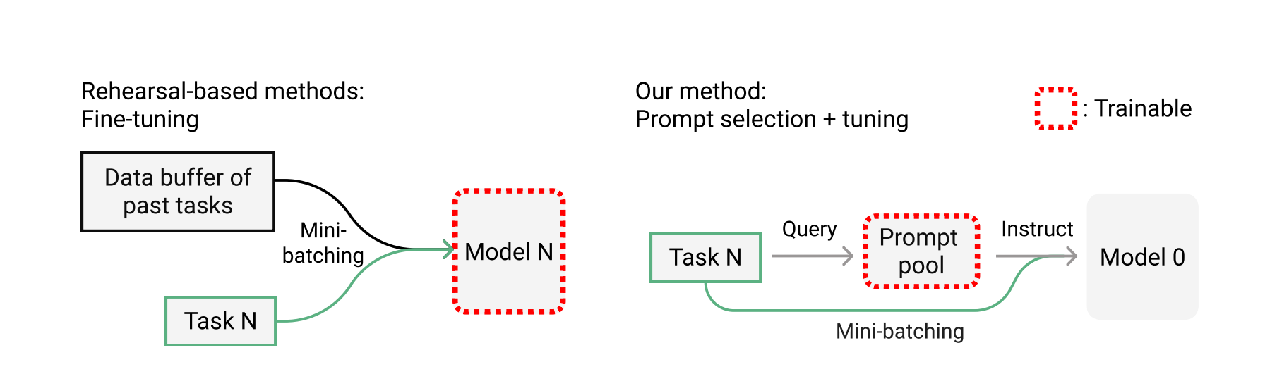
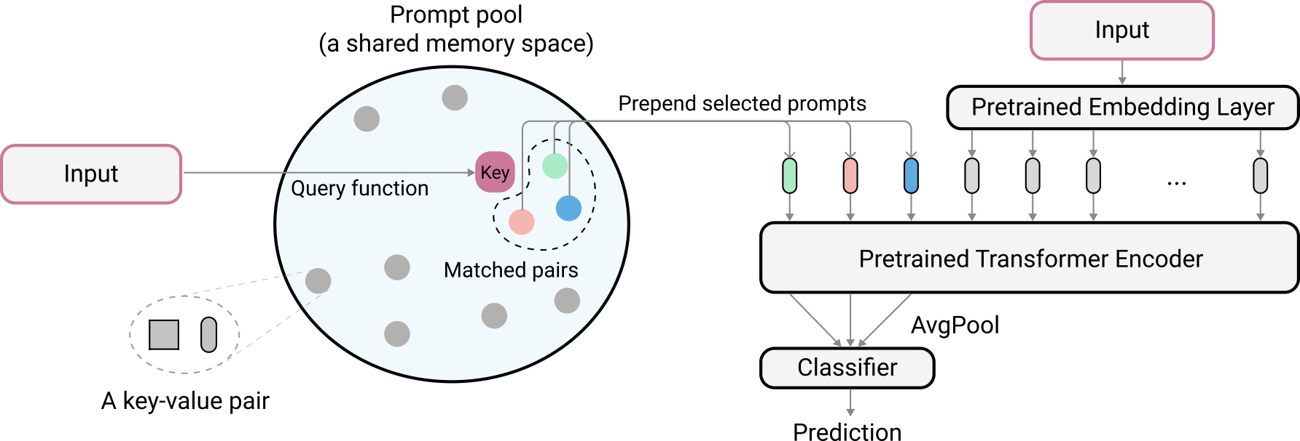
Learn to prompt
Credit: L2p for Continual Learning

Slide 7
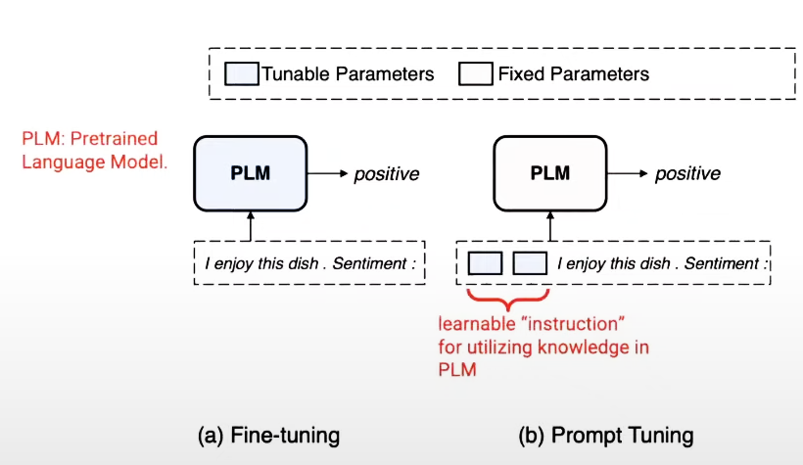
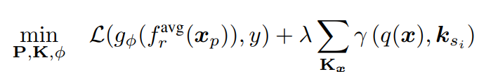
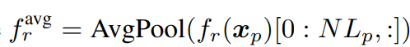
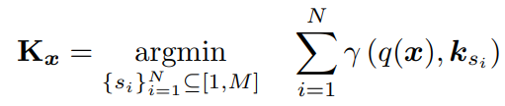
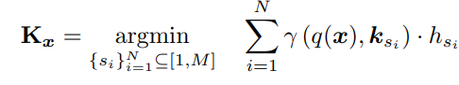
Prompt tuning and loss function
Loss Function:
Where,
Kx represents the subset of top-N keys selected specifically for x from K
γ : R^{Dk} × R^{Dk} → R as a function to score the match between the query and prompt key

Slide 8
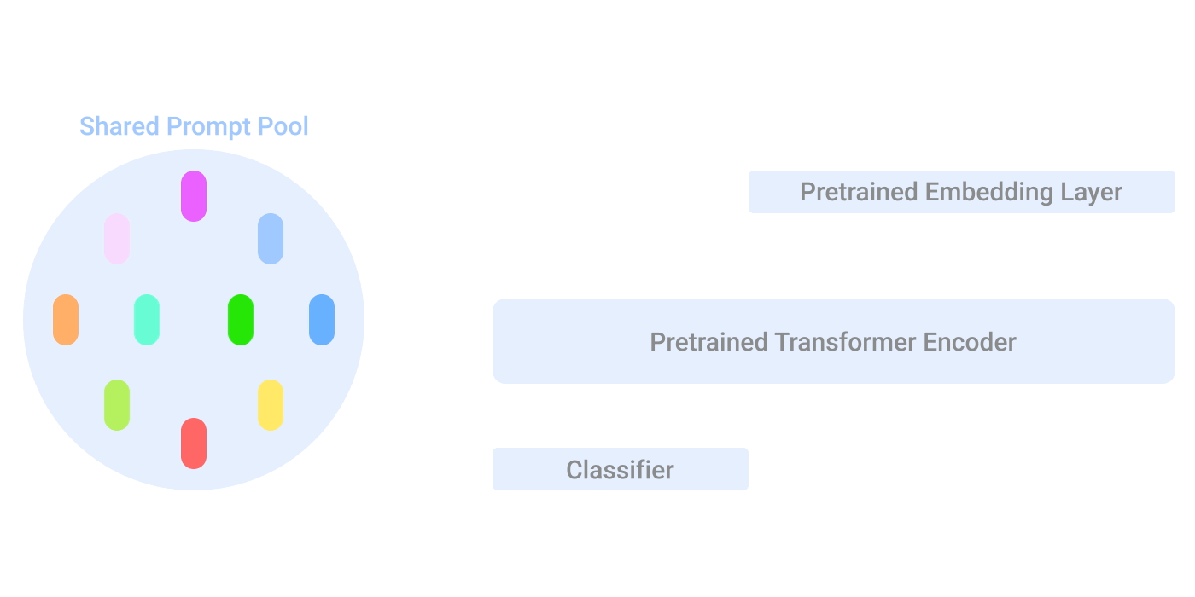

Illustration of L2p at test time
Credit: Google Blog post

Slide 9
Output
cifar100
Imagenet-R
 | Acc@1 | Acc@5 | Loss
Task 1 | 84.600 | 98.000 | 0.653
Task 2 | 81.500 | 96.700 | 0.753
Task 3 | 83.000 | 97.200 | 0.657
Task 4 | 83.900 | 96.400 | 0.659
Task 5 | 88.000 | 97.500 | 0.563
Task 6 | 77.200 | 97.600 | 0.810
Task 7 | 81.400 | 96.100 | 0.726
Task 8 | 81.200 | 96.700 | 0.697
Task 9 | 87.800 | 98.500 | 0.469
Task 10 | 86.600 | 98.800 | 0.517
 | Acc@1 | Acc@5 | Loss
Task 1 | 55.538 | 74.615 | 2.132
Task 2 | 62.267 | 77.333 | 2.023
Task 3 | 52.693 | 80.796 | 2.078
Task 4 | 49.826 | 74.653 | 2.272
Task 5 | 57.263 | 76.257 | 2.146
Task 6 | 57.168 | 79.032 | 2.063
Task 7 | 54.578 | 75.045 | 2.315
Task 8 | 59.326 | 74.831 | 2.206
Task 9 | 75.120 | 86.762 | 1.501
Task 10 | 64.986 | 80.115 | 1.944
Dataset | Acc@1 | Acc@5 | Loss | Forgetting | Backward
Cifar100_l2p | 83.5200 | 97.3500 | 0.6504 | 6.7333 | -6.6000
Imagenet-R | 58.8765 | 77.9441 | 2.0681 | 8.2327 | -8.2327
Cifar100 (modified) | 81.2327 | 95.5000 | 0.6612 | 7.2575 | -6.9753

Slide 10
Limitations:
Single prompt pool
> Doesn’t replicate human brain functioning.
> Inevitable interference between task-specific and task-invariant knowledge.
Still needs rehearsal data to outperform rehearsal-based methods.
Attach prompt only at the input.
It does not acknowledge which specific task it is prone to forgetting.
Our Contribution:
L2p was not evaluated in Imagenet – R dataset, So, we evaluated and the performance was not satisfactory.
We tried individual prompt but the performance still lagging.
We further implemented Dual prompt technique which is further extension of L2p and compare the results on Imagenet-R and cifar100.
We also tried L2p on TinyImagenet but due to server issue training could not complete

Slide 11
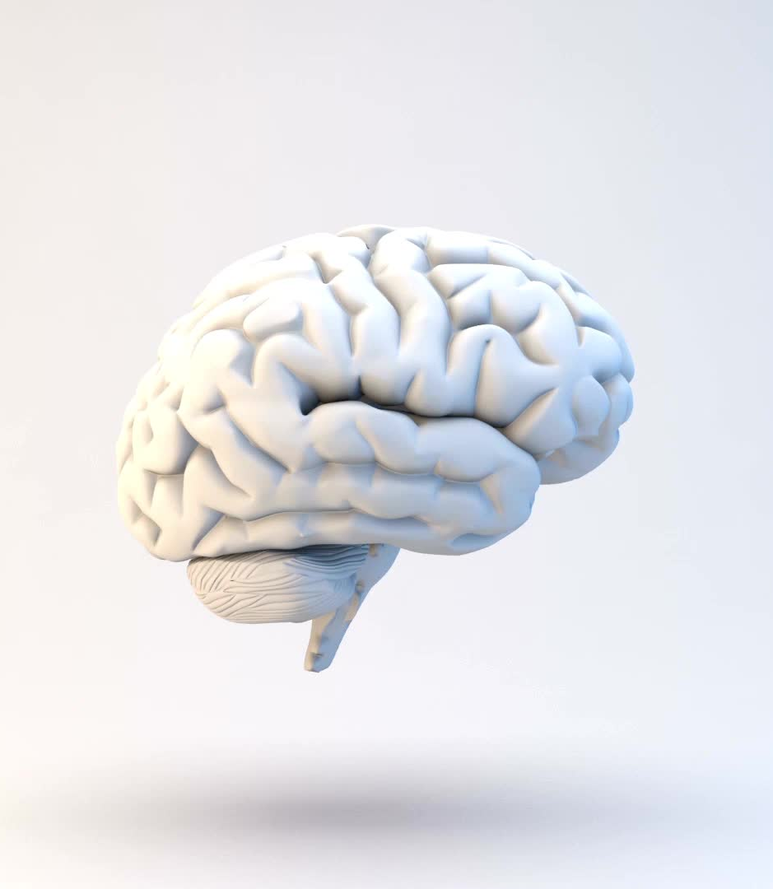
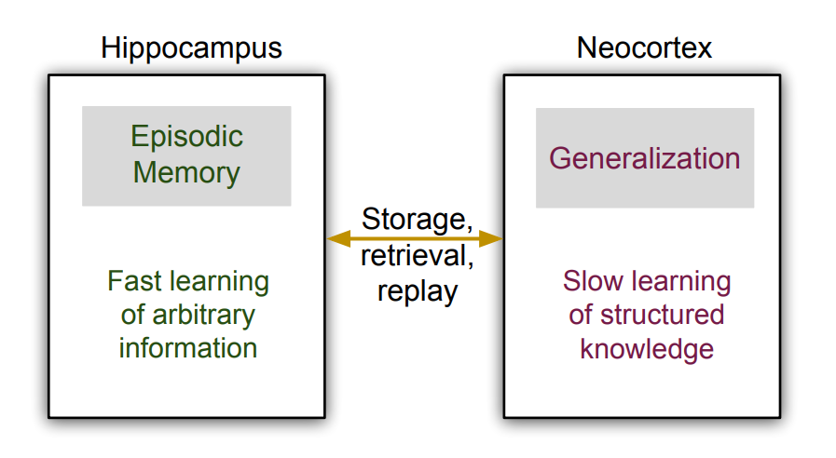
Credit: Continual Lifelong Learning with Neural Networks
Human Brain

Slide 12
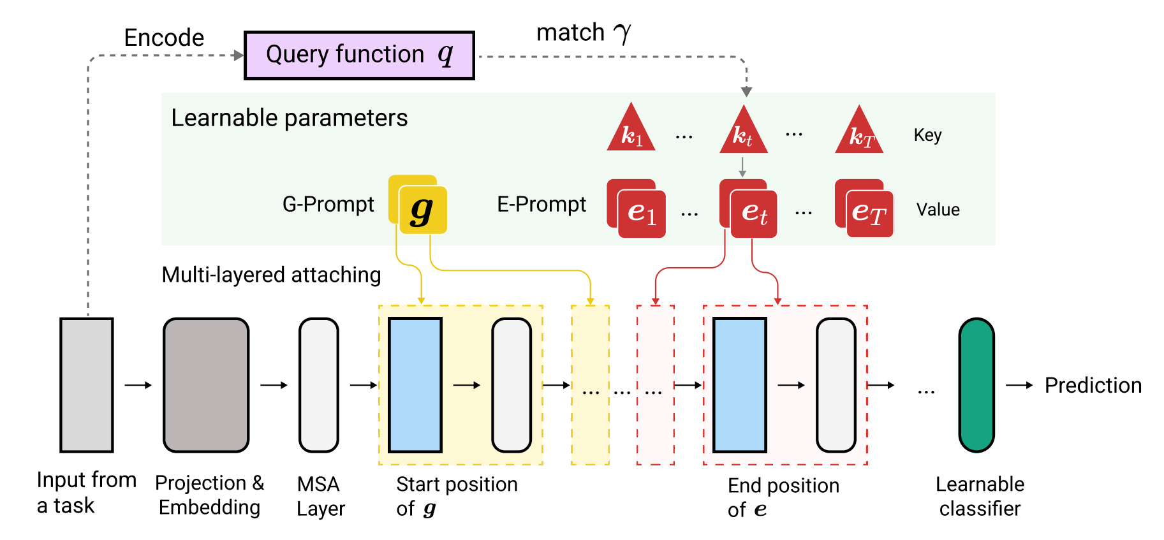
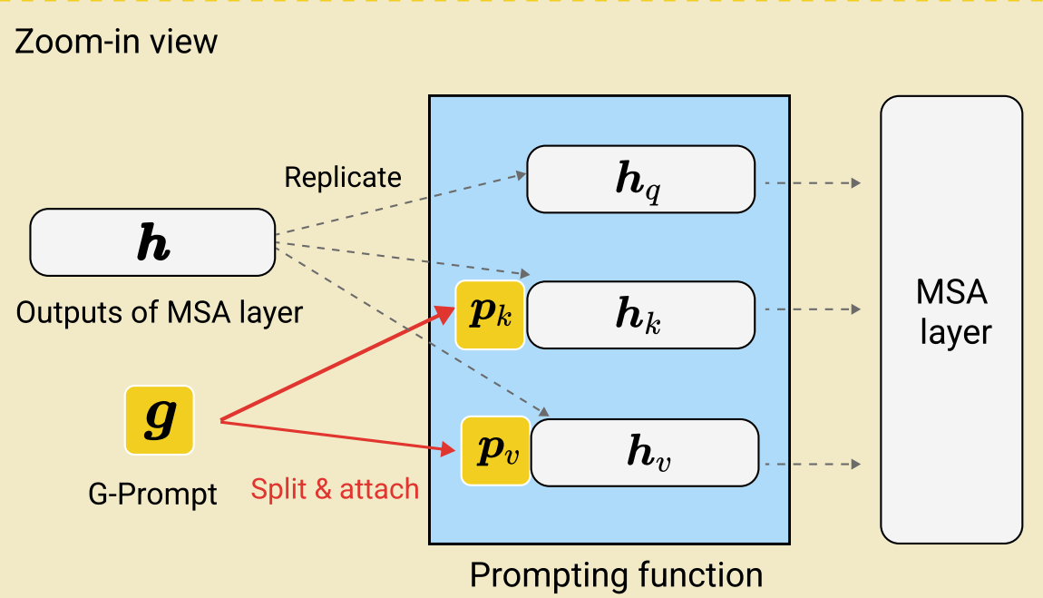
Dual Prompt
Credit: Dual Prompting: Complementry Prompting for rehearsal free continual learning.

Slide 13
Output & Comparision
L2p
Dataset | Acc@1 |  | Acc@5 | Loss | Forgetting | Backward
Cifar100_l2p | 83.5200 |  | 97.3500 | 0.6504 | 6.7333 | -6.6000
Imagenet-R | 58.8765 |  | 77.9441 | 2.0681 | 8.2327 | -8.2327
Dual Prompt
Dataset | Acc@1 | Acc@5 | Loss | Forgetting | Backward
Cifar100_l2p | 85.4700 | 97.8200 | 0.5615 | 5.3889 | -5.3997
Imagenet-R | 60.2027 | 77.9334 | 2.4525 | 2.5463 | -1.6067

Slide 14
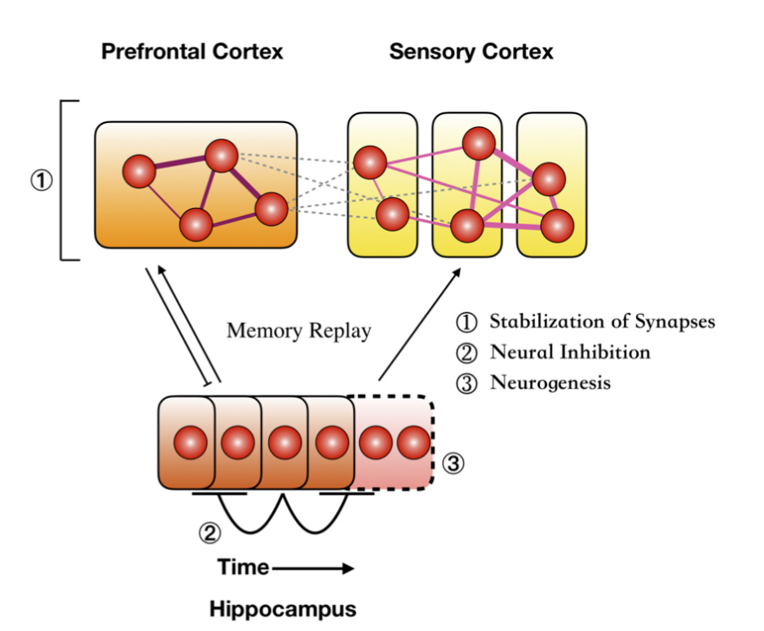
Novel Idea
Instead of adding only two prompt pool adding three can be beneficial imitating brain functioning suggested by triple memory network.
We can use Active Learning in which model itself chooses to train on the tasks it is forgetting.
Credit: Triple-Memory Networks: A Brain-Inspired Method for Continual Learning

Slide 15
Thank You

